Slide 1
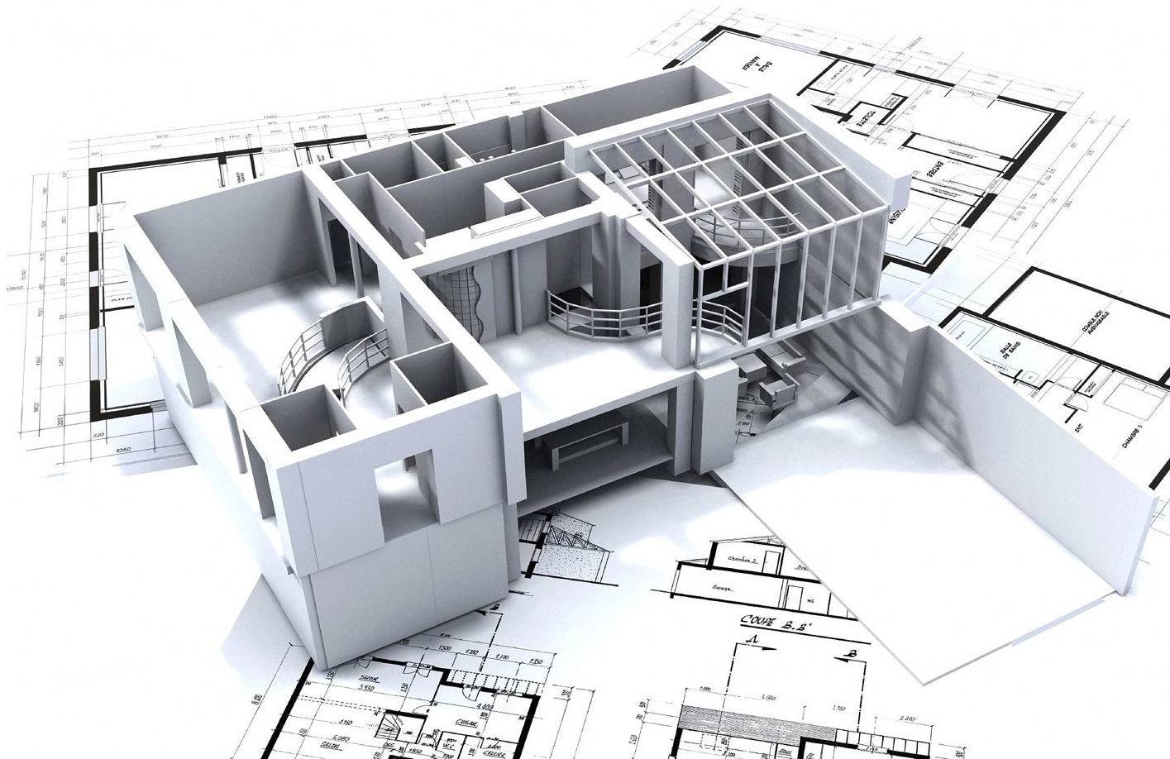

Node
Architecture
Server Side Development / Web Programming
V8 Engine
How was it built?

Slide 2

JavaScript Engine
Server Side Development / Web Programming
Before node JavaScripts could only run in a browser
Each browser had it’s own engine to run JavaScript
The browser’s JavaScript Engine converted the JavaScript to Machine Code
JS CODE
MACHINE CODE

Slide 3
JavaScript Engine
Server Side Development / Web Programming
V8
Chakra
SpiderMonkey
JavaScript Engine
JavaScript Engine
JavaScript Engine

Slide 4

The Invention of
Node
Server Side Development / Web Programming
V8
Engine
He essentially turned the Google V8 JavaScript Engine into an application that can run JavaScript
2009
Ryan Dahl
Invents Node

Slide 5


JavaScript
Server Side Development / Web Programming
In Node we have new Objects like fs & http
Objects
document.getElementById(’) - Browser
fs.readFile() - Node
http.createServer(); - Node

Slide 6
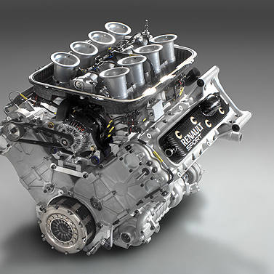
A peep at some distant orb has power to raise and purify our thoughts like a strain of sacred music.
“
Node is a runtime environment for executing JavaScript
Built on the Google V8 Engine
It is not a Programming Language
It has a Framework

